Slide 1
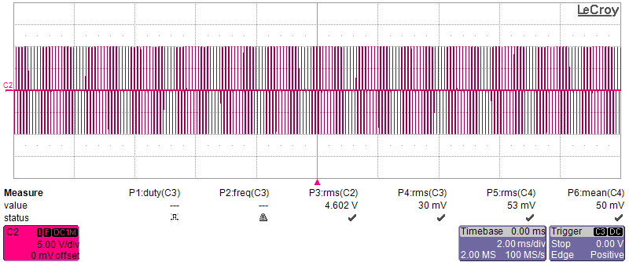
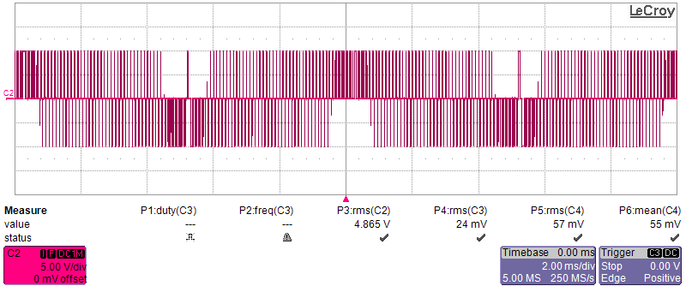
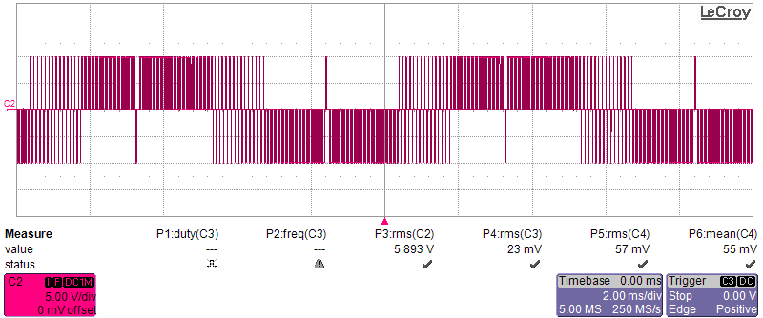
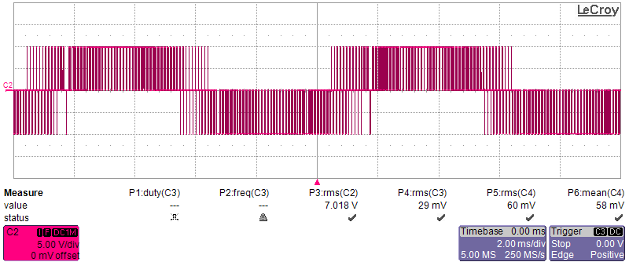




$$m_{a}=0, f_{sw}=10kHz, f_{o}=100Hz$$
$$m_{a}=0.3, f_{sw}=10kHz, f_{o}=100Hz$$
5V/div 2ms/div
5V/div 2ms/div
(a)
(b)
$$m_{a}=0.6, f_{sw}=10kHz, f_{o}=100Hz$$
$$m_{a}=0.86, f_{sw}=10kHz, f_{o}=100Hz$$
5V/div 2ms/div
5V/div 2ms/div
(c)
(d)

Slide 2
5V/div 2ms/div
5V/div 2ms/div
(a)
(b)
5V/div 2ms/div
5V/div 2ms/div
(c)
(d)

Slide 3
Switching frequency and its sidebands
5V/div 2ms/div
Fundamental frequency

Slide 4
Switching frequency and its sidebands
5V/div 2ms/div
Fundamental frequency

Slide 5
Switching frequency and its sidebands
5V/div 2ms/div
Fundamental frequency

Slide 6
5V/div 2ms/div

Slide 7
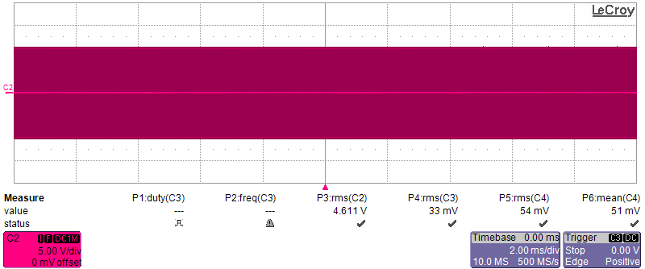
Switching frequency and its sidebands
Fundamental frequency
5V/div 2ms/div

Slide 8
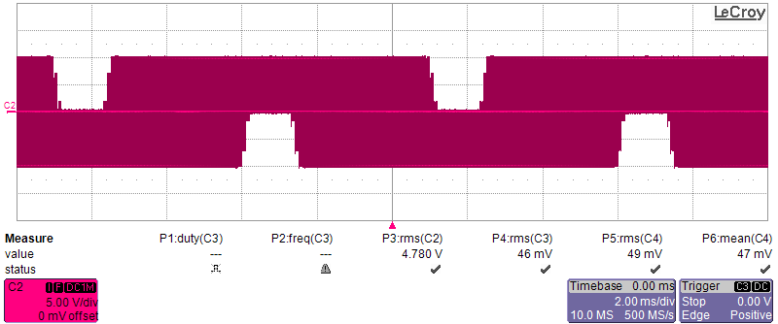
Switching frequency and its sidebands
Fundamental frequency
5V/div 2ms/div

Slide 9
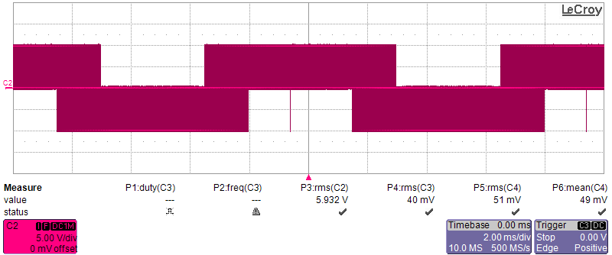
Switching frequency and its sidebands
Fundamental frequency
5V/div 2ms/div

Slide 10
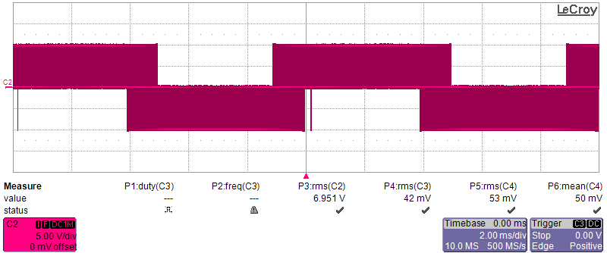
Switching frequency and its sidebands
Fundamental frequency
5V/div 2ms/div

Slide 12
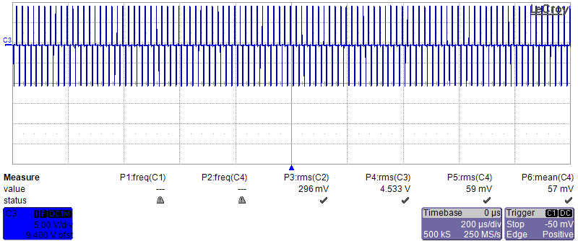
0.43

Slide 13
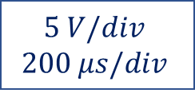
0.43
$$5 V/div$$
$$200 μs/div$$

Slide 14
0.43
$$5 V/div$$
$$200 μs/div$$

Slide 15
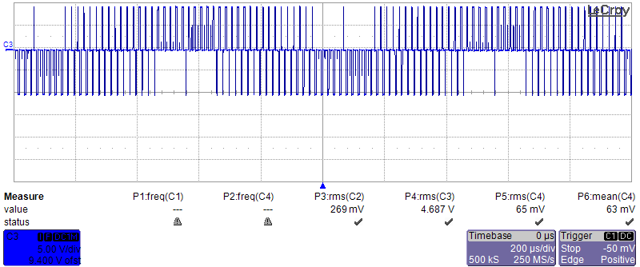
0.42
0.23
0.02
0.02

Slide 16
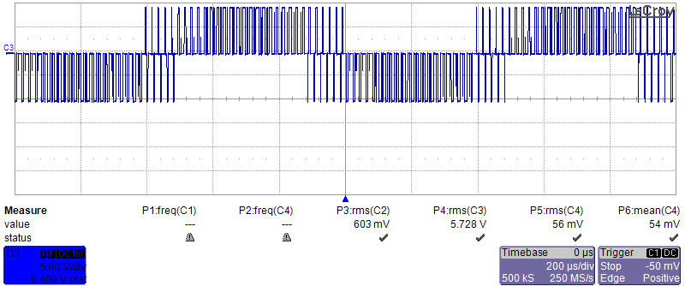
0.48
0.40
S0.10
0.10

